Slide 1



AtliQ Mart Promotion Analysis
Prepared by:
Mitika Mahajan

Slide 2
Agenda
Introduction
Primary Goal
Methodology
Results
Discussion
Recommendations

Slide 3

Introduction
AtliQ Mart is a retail giant with over 50 supermarkets in the southern region of India. All their 50 stores ran a massive promotion during the Diwali 2023 and Sankranti 2024 (festive time in India) on their AtliQ branded products. Now the sales director wants to understand which promotions did well and which did not so that they can make informed decisions for their next promotional period.
3

Slide 4


Primary Goal
To
understand
Which Promotion
did well

Slide 5
Methodology
Data Exploration
Presentation
Using MS SQL
Using MS Powerpoint
Data Collection
From Codebasics website
Data Cleaning
Data Visualization
Using MS SQL
Using Power BI
Notes:
Data Collection-
Data Exploration-
Data Cleaning-
Data Visualization
Presentation

Slide 6
Adhoc requests and execution
Use of MSSQL

Slide 7
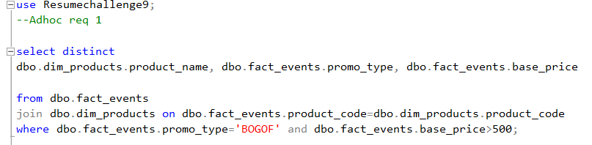
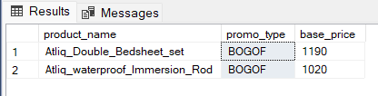
List of products with base price >500 and promo_type - BOGOF
use Resumechallenge9; - To use the desired database
select distinct – To get the unique values
from dbo.fact_events – The data needs to been extracted from the mentioned table
where dbo.fact_events.promo_type='BOGOF' and dbo.fact_events.base_price>500; - Condition
7

Slide 8
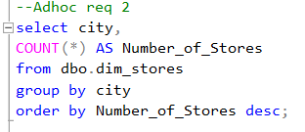
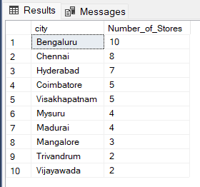
List of no. of stores in each city in descending order
select – To get the values
Count (*) – To count number of stores
Group By – To get the results grouped by column city
Order By – To sort the results in specific order
Desc – To sort the results in descending order
8

Slide 9
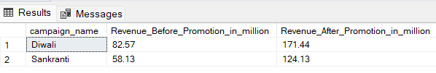
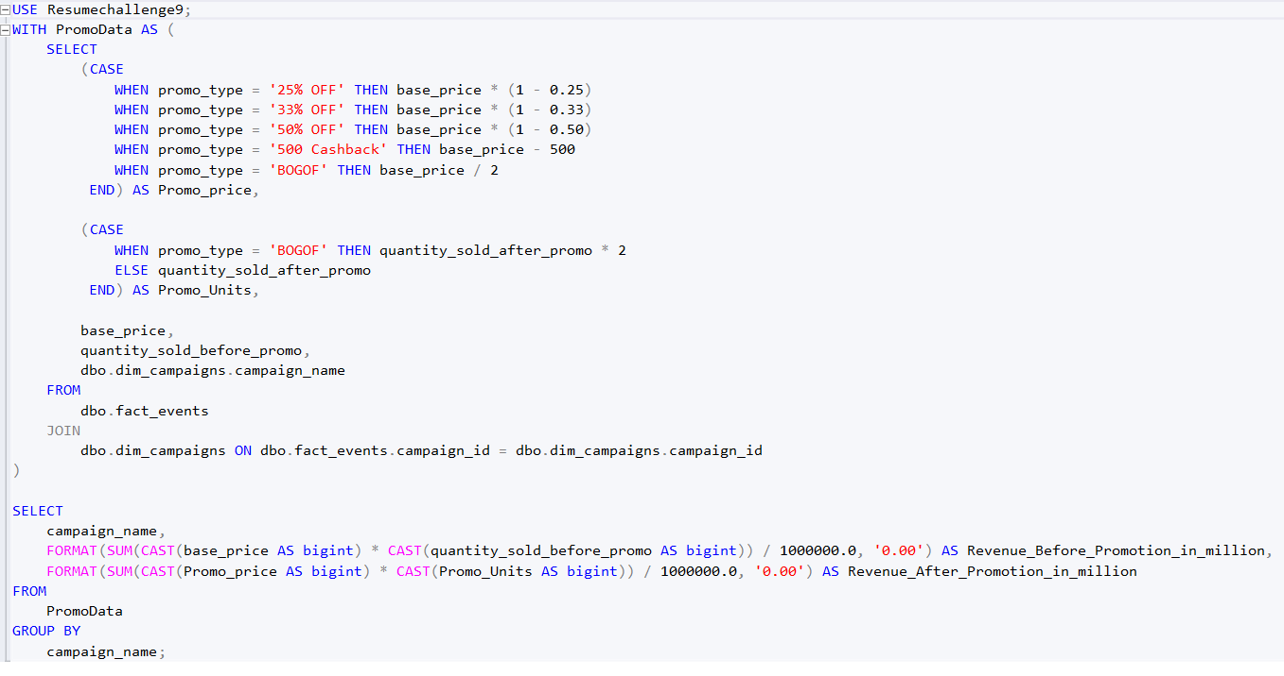
Revenue before and after promotion for both campaigns
9

Slide 10
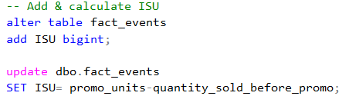
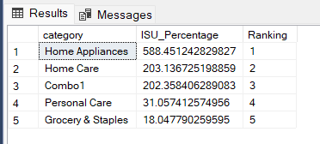
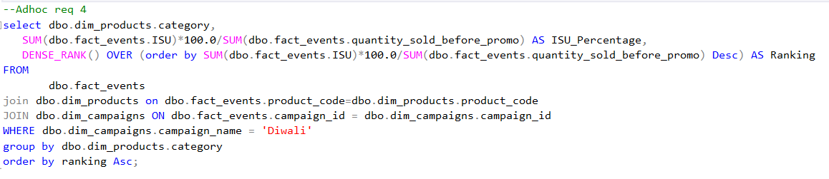
ISU% for each category for Diwali Campaign
10

Slide 11
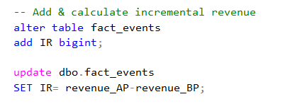
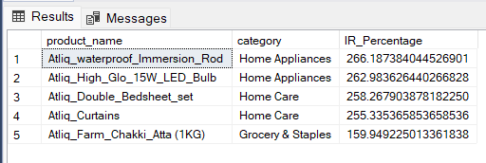
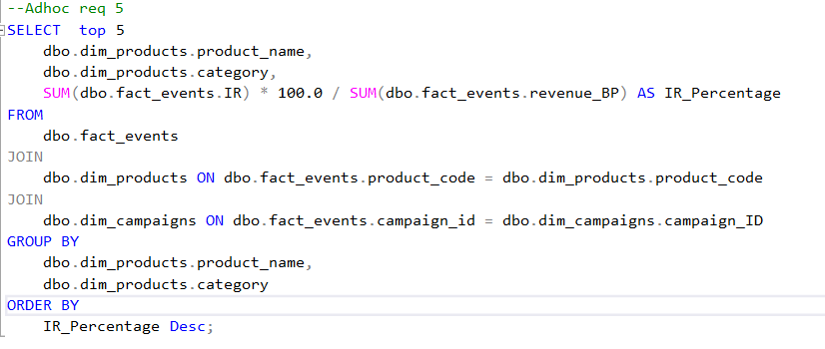
Top 5 products by IR%
11

Slide 12
Results
Insights from Data Visualization

Slide 13
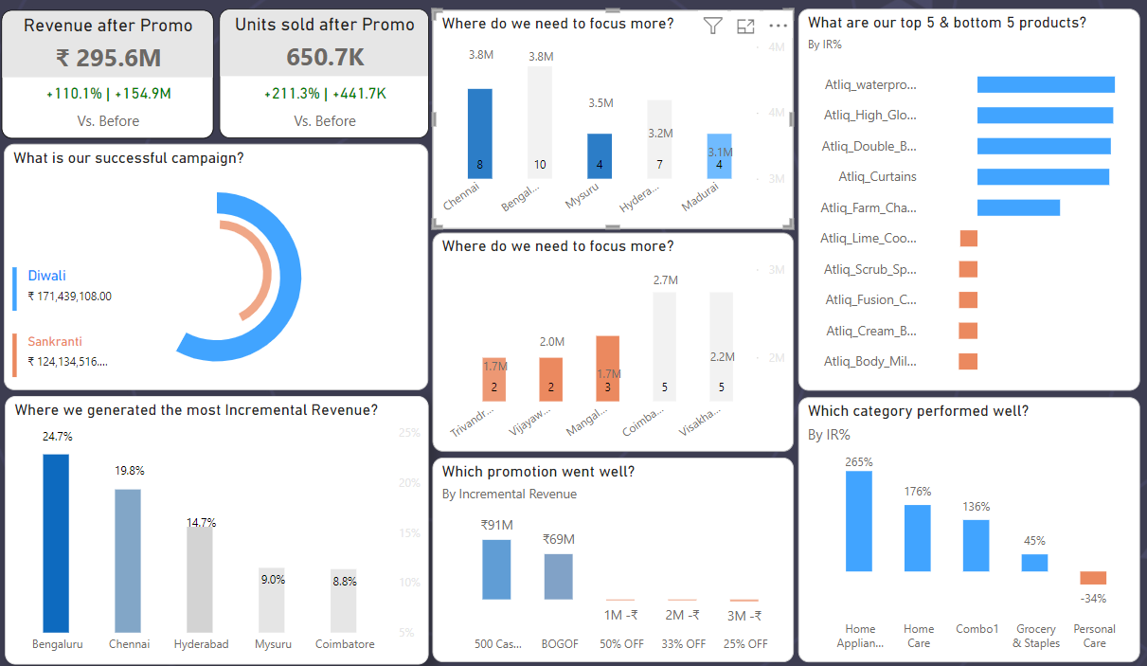
Overview

Slide 14
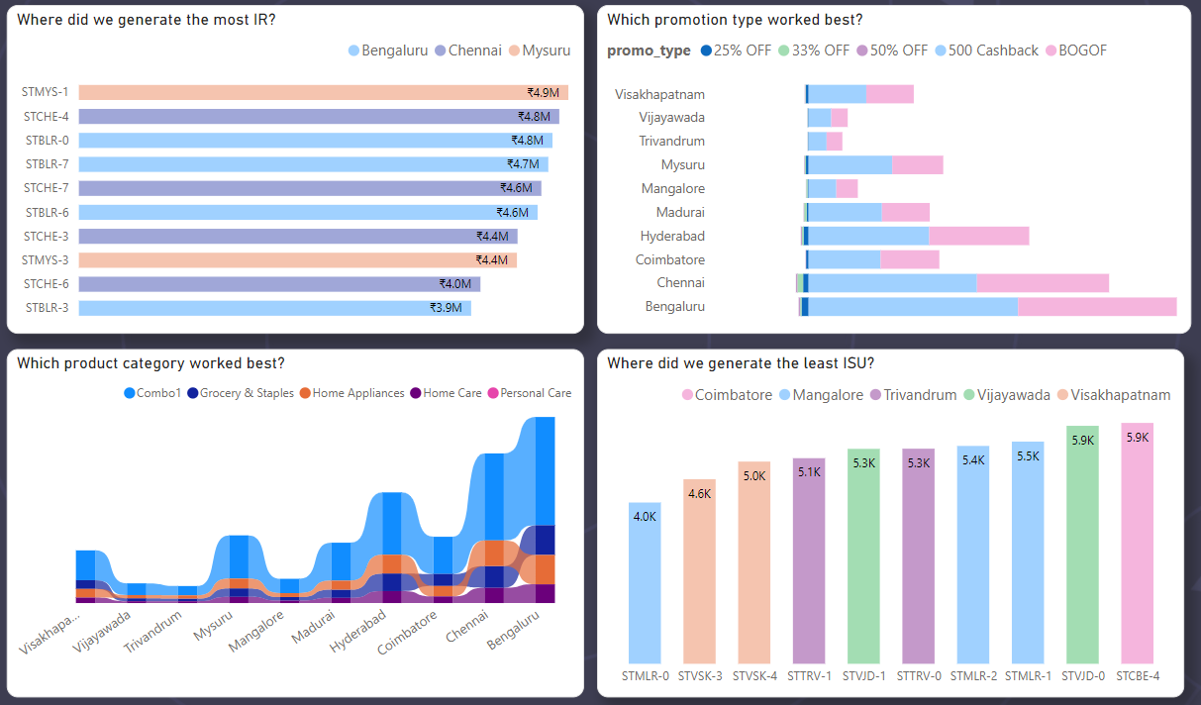
Store Performance

Slide 15
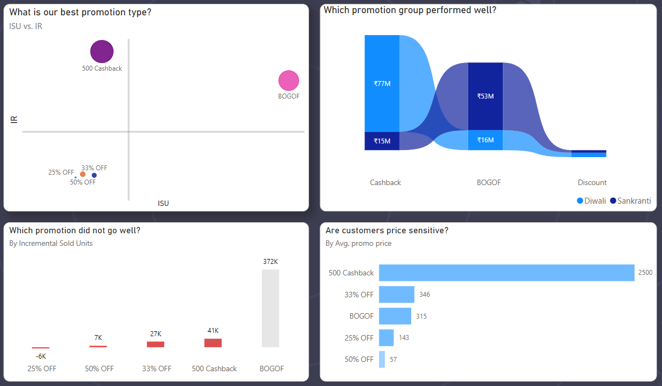
Promotion performance

Slide 16
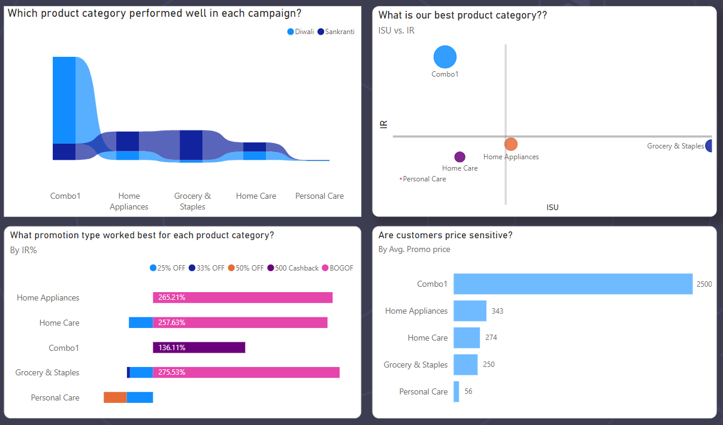
Product performance

Slide 17
Discussion
Campaign Success
Store Performance
Promotion Success
Product Analysis
Diwali revenue was 38% more than that of Sankranti revenue after promotion.
During Sankranti campaign, the selling of units was increased by 334.1K, but it increased the revenue by only 66.0M. This shows that during Sankranti people bought a few high-Valued products.
Bangaluru has contributed 24.7% of total incremental revenue, while Chennai has earned maximum average IR per store.
For expansion purpose, the company should focus on Chennai, Mysuru, and Madurai.
Trivandrum and Mangalore stores need to be focused more to generate revenue.
BOGOF is the star promotion type with a balance between ISU and IR, while all discount promotions failed to achieve even above average ISU or IR.
500 cashback promotion has driven the 59% of total IR.
During Diwali, Cashback promotion performed well, while during Sankranti BOGOF performed well.
No product category has achieved above average IR and ISU, though combo 1 has achieved the above average IR.
58.8% of total IR for all categories is driven by combo 1 product category.
Personal care product category has earned 34% less during promotions, while home appliance category’s revenue is increased by 265%.

Slide 18


Recommendations
Expansion and Corrections
Chennai, Mysuru, and Madurai are the cities with high potential for expansion. Expansions should be planned in these cities respectively.
Trivandrum, Vijayawada, and Mangalore need to be focused to identify the root cause for poor performance in terms of average store revenue.
Promotion type
Customers prefer to buy product combos opposed to individual products. Hence, the company should focus on combos to increase the revenue.
Discounts are not preferred offers for the customers.
Product types
Personal care products should be promoted using different promotion strategies like cashback or BOGOF.
Home care and personal care products should be bundled to improve the IR and ISU.

Slide 19




Thank you

